Slide 1
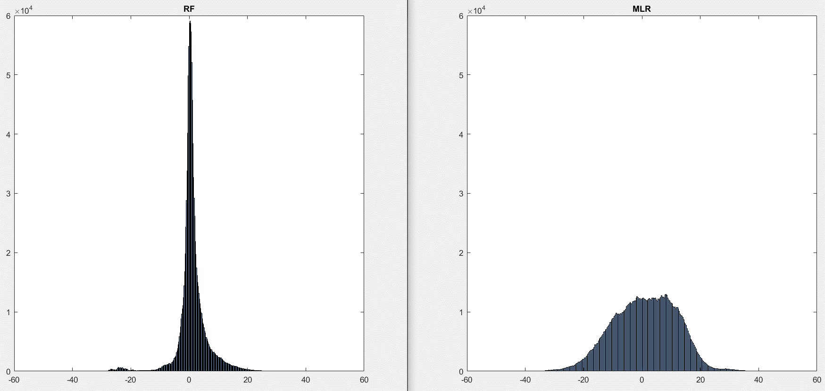
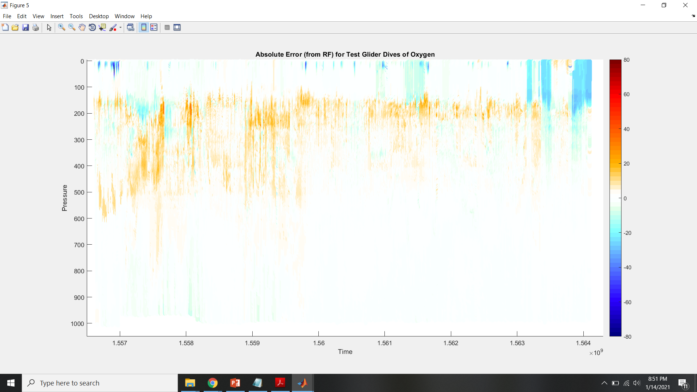
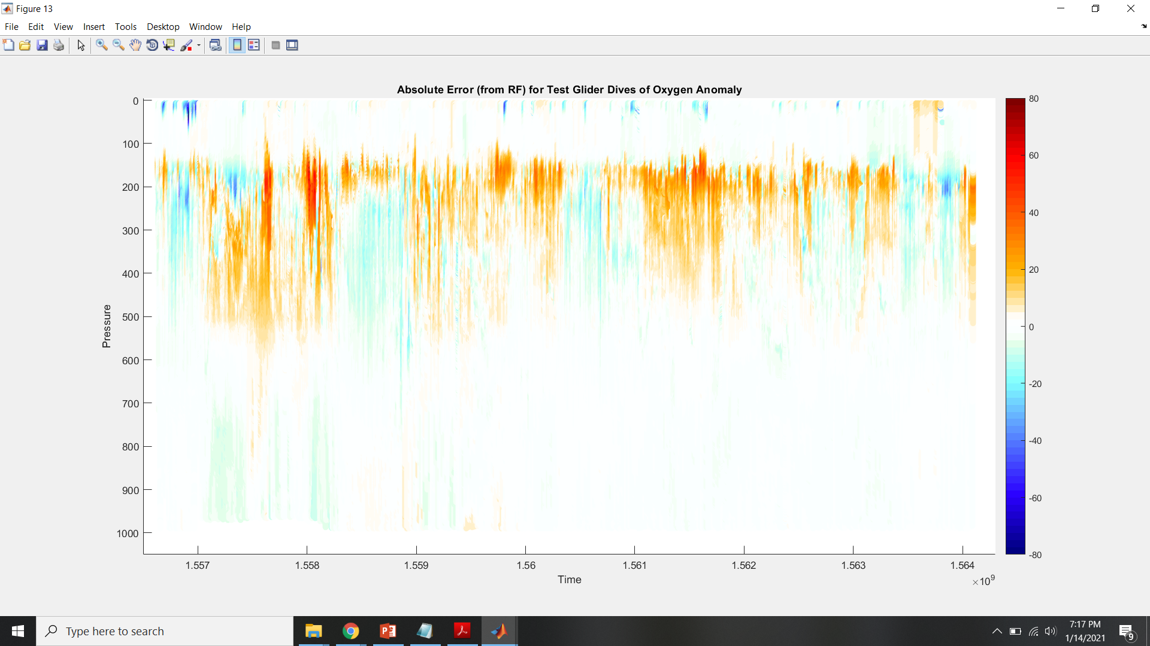
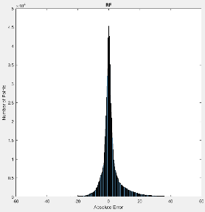
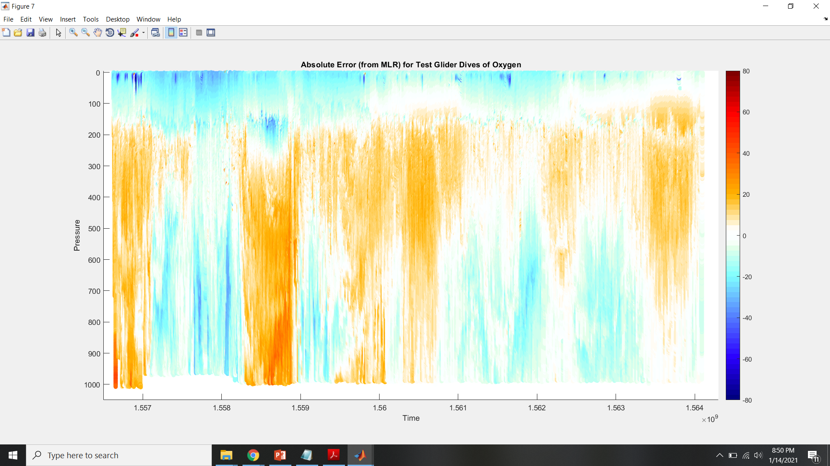
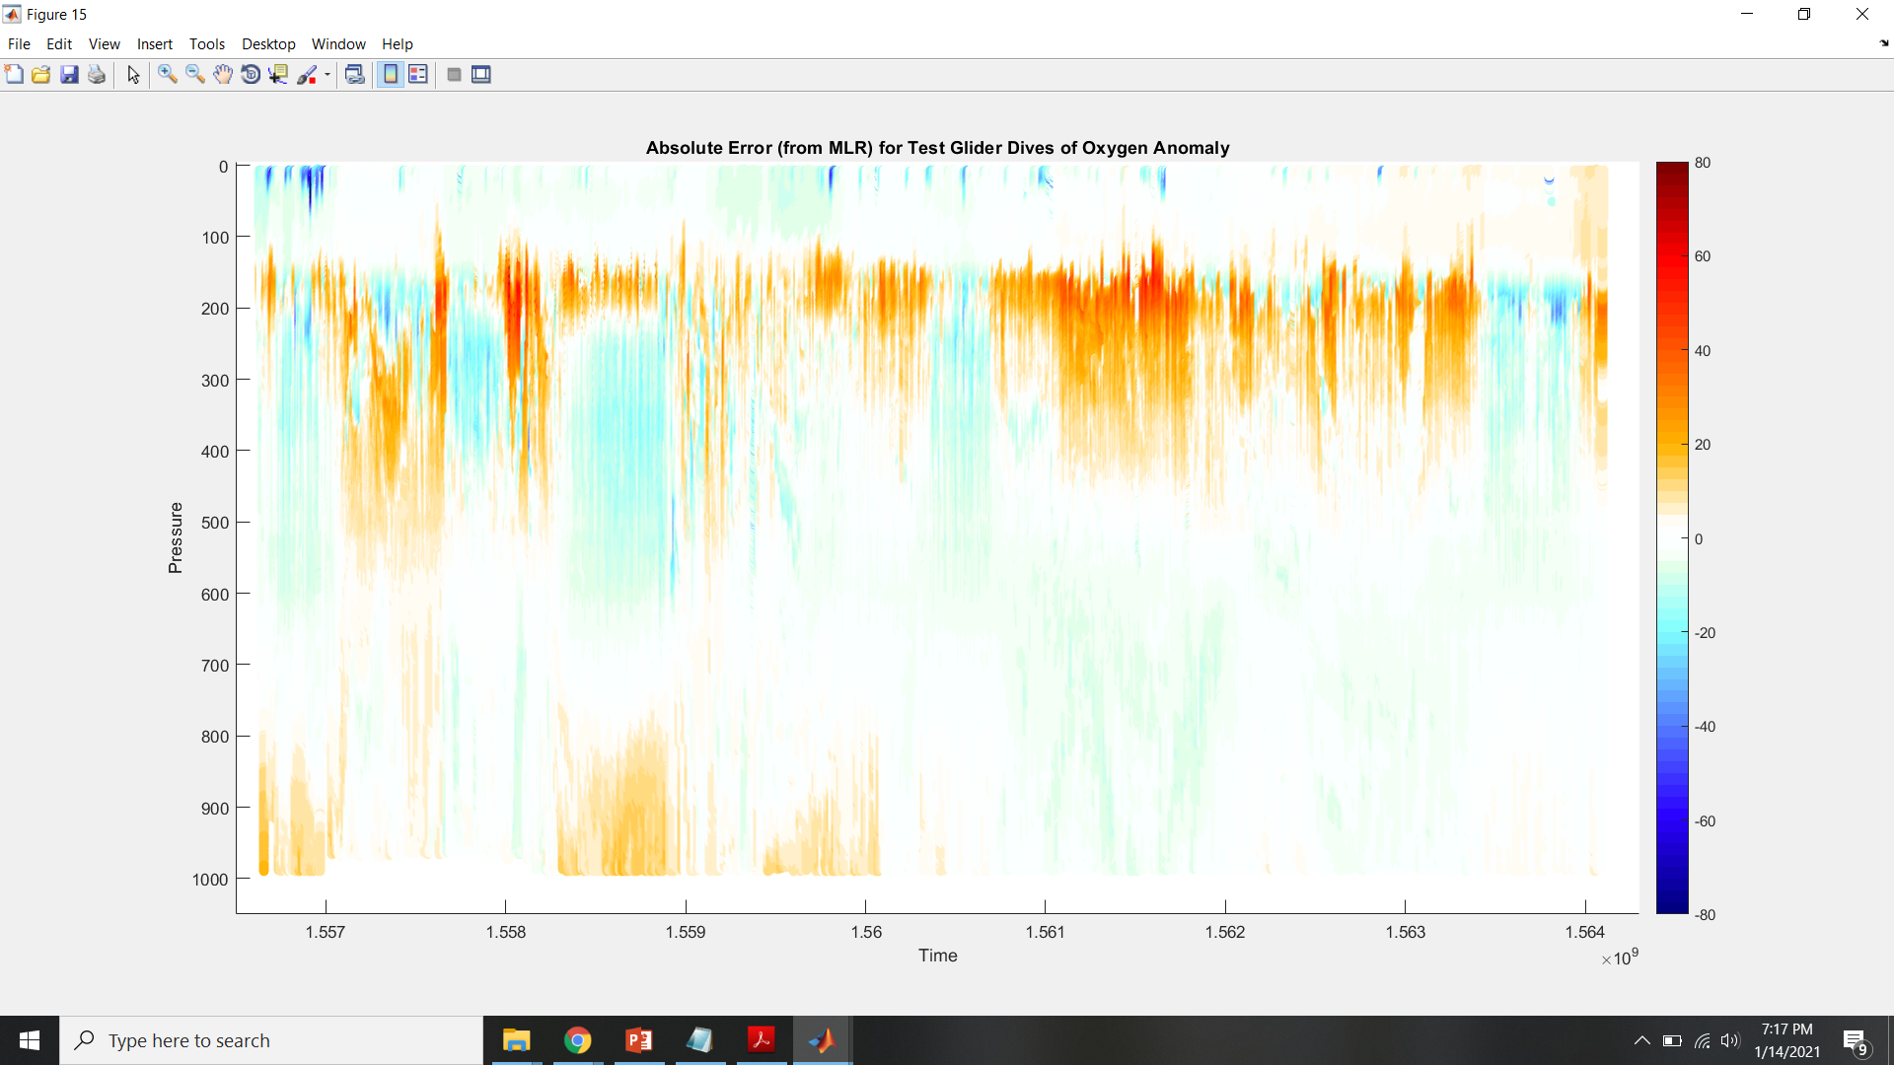
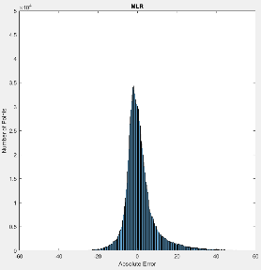
-MLR does better in anomaly case than in original case; RF does worse in anomaly case than in original case
-RF in original case does the best
Median AE = 0.6540
Median AAE =
1.4118
Median AE = 0.3325
Median AAE =
1.9051
RF, Oxygen
RF, Oxygen Anom.
Median AE = 1.4869
Median AAE = 7.9995
R²_{training} = 0.9715
Median AE = -0.1695
Median AAE = 3.3066
R²_{training} = 0.3861
MLR, Oxygen
MLR, Oxygen Anom.

Slide 2
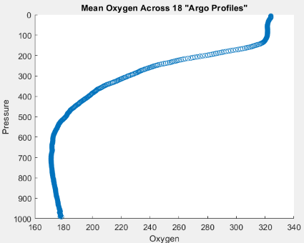
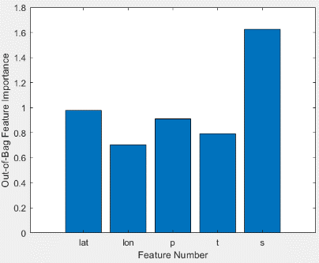
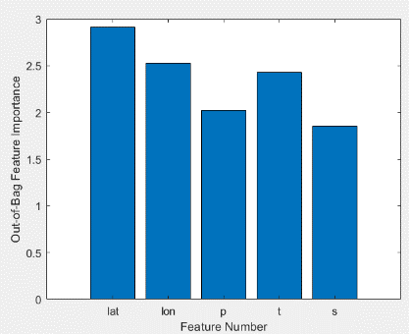
Original Case
Anomaly Case

Slide 3
Weird Near-Surface Measurements in SG 659

Slide 4
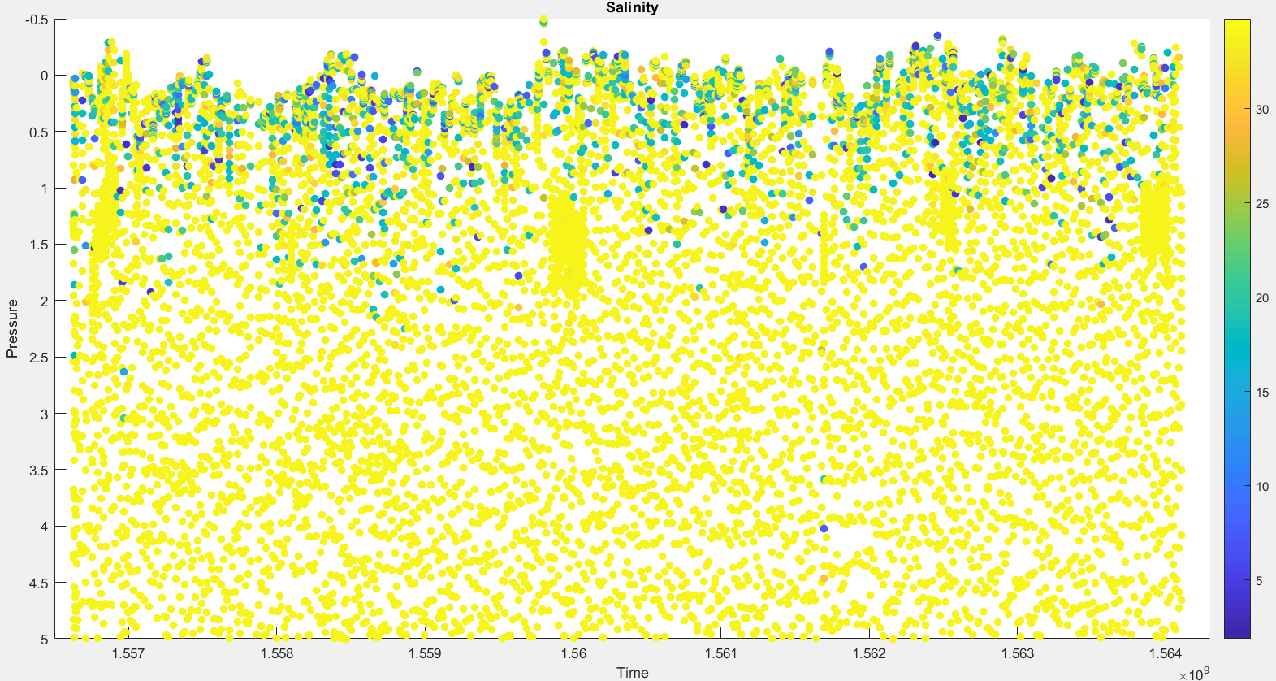

Slide 5
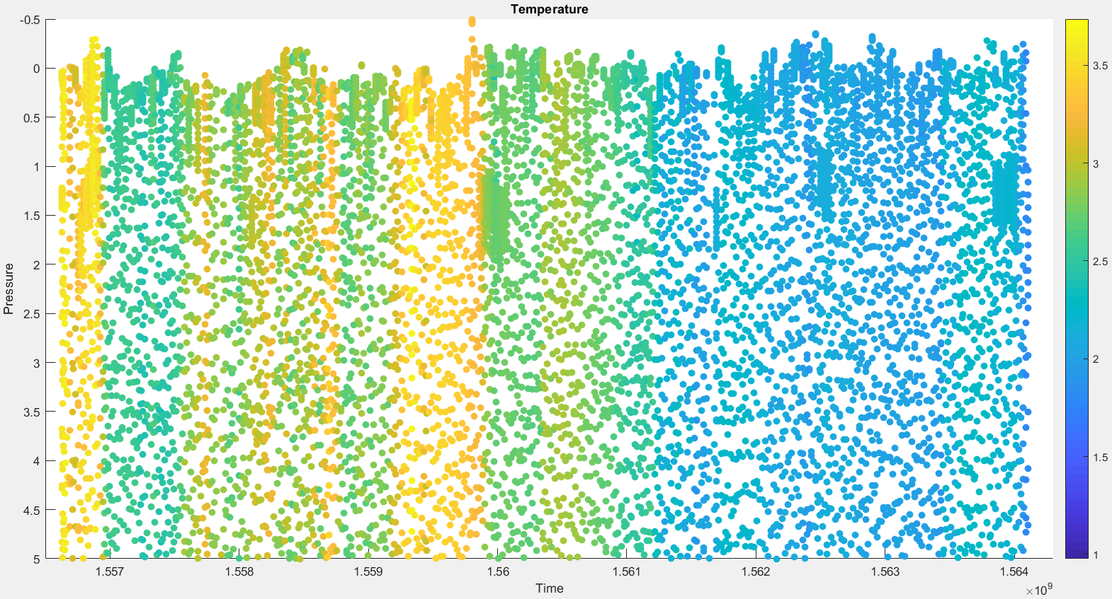

Slide 6
